Slide 1
Introduction to Programming in Python
Ezekiel Adebayo Ogundepo (@gbganalyst)

Slide 2
Introduction to Python libraries

Slide 3
Python packages
A library is a collection of Python functions that are written in Modules to extends basic Python functionality. A library can contain a set of functions relating to a specific topic or tasks. For example, Pandas for data manipulation and analysis, NumPy for scientific computing and manipulation n-dimensional arrays, Matplotlib and Seaborn for data visualization while scikit-learn is for building machine learning models.

Slide 4
Basic terms in libraries
Module is a file which contains various Python functions with the .py extension file which has python executable code.
Package is a collection of modules.
Library is a collection of packages.

Slide 5
How to import Python package
Before you can use any function in a package, you will need to import the module that has that function. To import a module, simply type:
import module_name

Slide 6
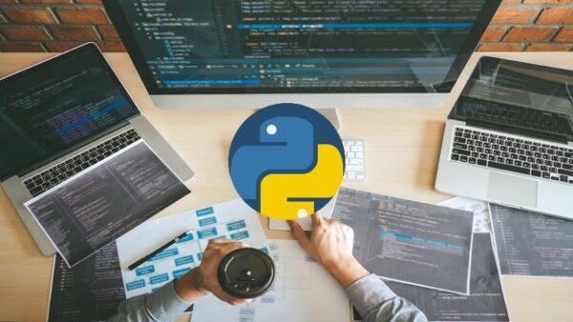
Lab session

